Slide 1
Data Visualization in R with ggplot2::
Meg Hartwick, PhD
March 3rd , 2021

Slide 2
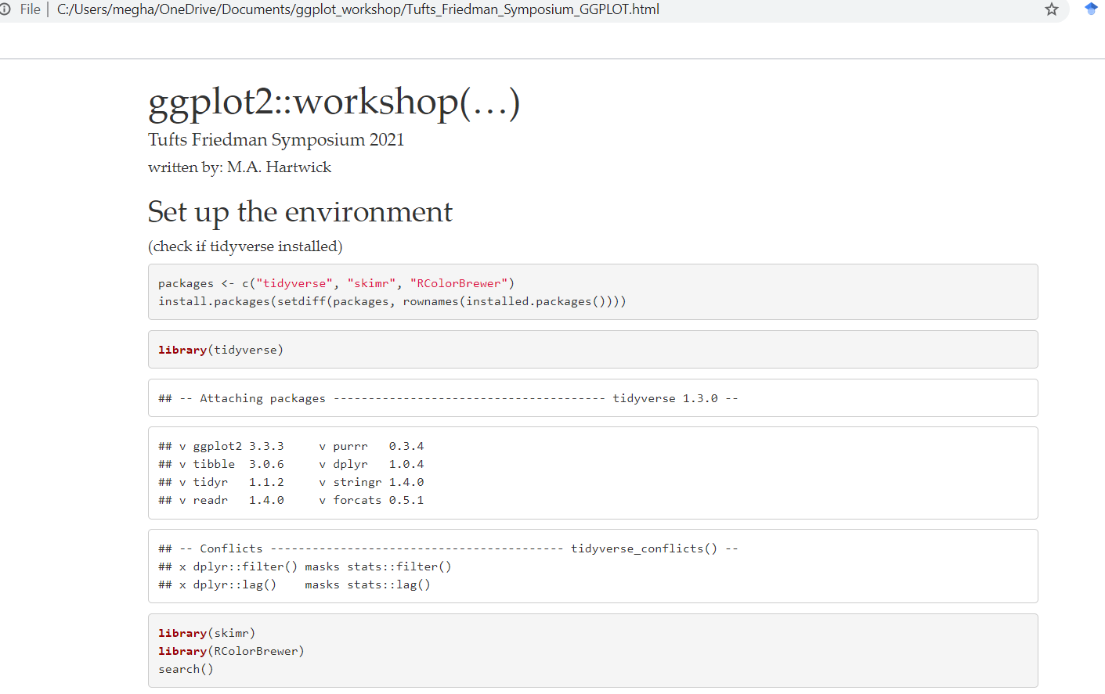
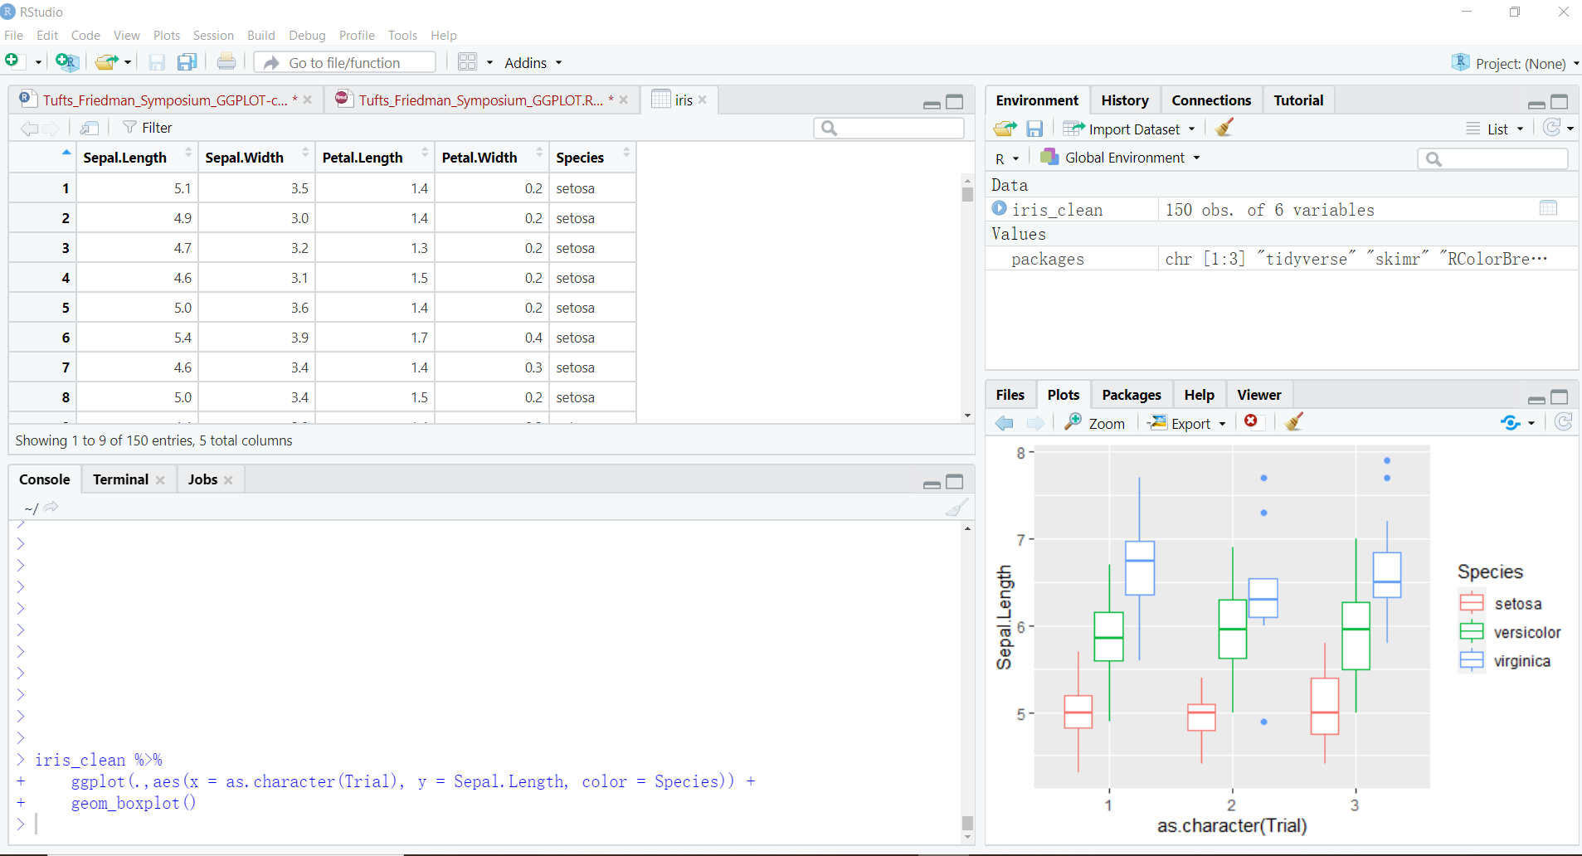
Workshop Overview
Materials Available at:
https://github.com/meghartwick/ggplot2-Workshop
PowerPoint Slides
HTML
Notebook and Code
Data Visualization in R with ggplot2::
Meg Hartwick, PhD
March 3rd , 2021

Slide 3
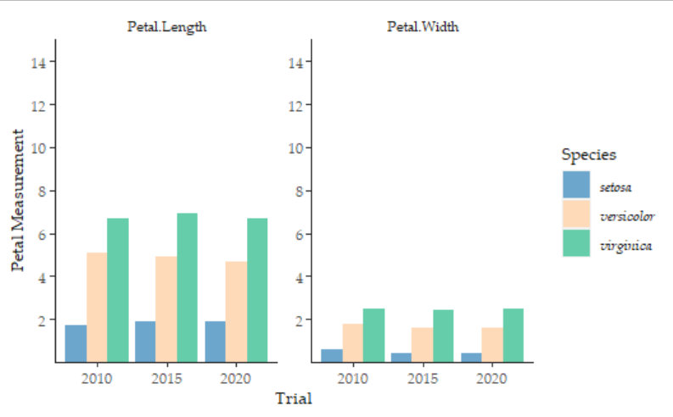
Workshop Overview
Flow
I. Foundation - Concept Review
II. Structure – ggplot2:: syntax
III. Application – Sketch to Story
100,000.00
Very Catchy Title
10,000.00
**
key point here
Log(Value)
1,000.00
***
100.00
*
10.00
2000
2010
2020
Time
ggplot(…)

Slide 4

Workshop Overview
Why do you usually make graphics?
For your own use.
Informal sharing with colleagues.
For formal presentations or publication.

Slide 5
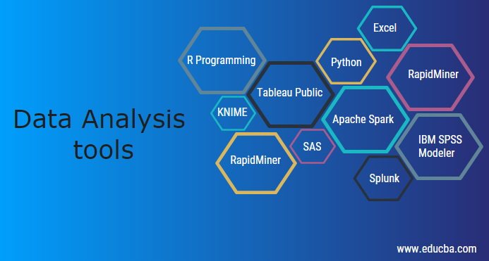
Workshop Overview
How do you usually make graphics?
Quick-and-dirty (excel).
Just OK (statistical software, eg: JPM, SAS).
Refined (Tableau, base R, some ggplot2).
Highly refined (R and Python Pro).

Slide 6
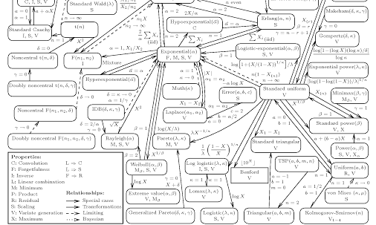
Workshop Overview
What makes for a good graphic?
1. Really busy with every detail in text…
2. Flashy plotting…
3. A clear message that tells a story…

Slide 7
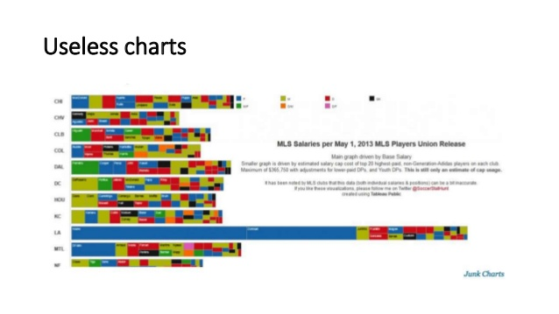
Workshop Overview
What makes for a good graphic?
1. Really busy with every detail in text…
2. Flashy plotting…
3. A clear message that tells a story…

Slide 8
Workshop Overview
What makes for a good graphic?
1. Really busy with every detail in text…
2. Flashy plotting…
3. A clear message that tells a story…
100,000.00
Very Catchy Title
10,000.00
key point here
Log(Value)
**
1,000.00
***
100.00
*
10.00
2000
2010
2020
Time

Slide 9
Workshop Overview
Today’s Goal
Understand how to develop graphics that:
Effectively tell a story
In ggplot2 (and some tidyverse)
Are refined or highly refined.
100,000.00
Very Catchy Title
10,000.00
**
key point here
Log(Value)
1,000.00
***
100.00
*
10.00
2000
2010
2020
Time
ggplot(…)

Slide 10
I. Foundation
1. Concepts
Foundations and Concepts Refresher
1. Data
Structure
Continuous
Discrete
Format
Wide
Long
2. Graph Attributes
Dimension
Axes scale
Symbols, color schemes etc.
3. Key Elements
Title
Axes labels
Embedded comments
2. Tidyverse
Very Catchy Title
3. ggplot2::
100,000.00
10,000.00
key point here
Log(Value)
**
1,000.00
***
100.00
*
10.00
2000
2010
2020
Time

Slide 11
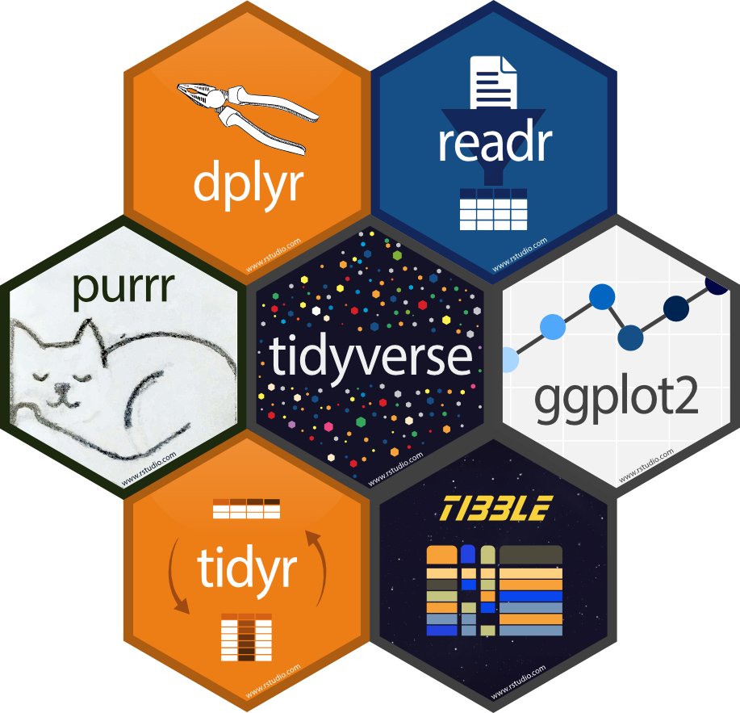
I. Foundation
1. Concepts
Tidyverse
Originally ‘Hadleyverse’
Collection of R packages with shared:
Philosophy
Structure
Syntax
Package ‘piping’ (%>%)
Functions act as verbs
Over 27 packages including:
readr – importing data
dplyr – data cleaning
ggplot2 – data visualization
lubridate – working with dates
stringr – working with strings
2. Tidyverse
3. ggplot2::

Slide 12
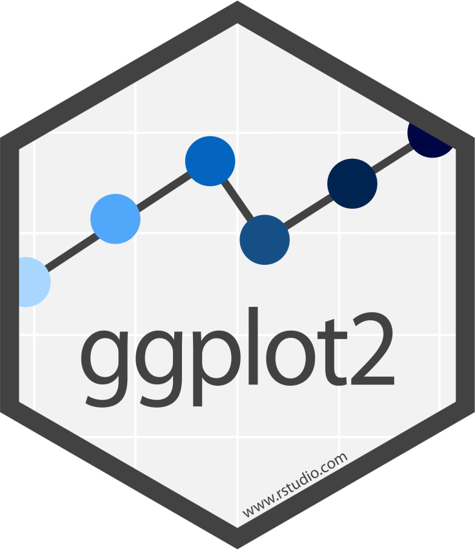
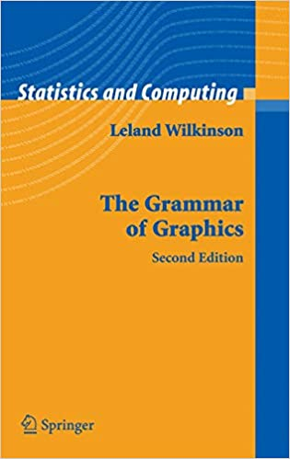
I. Foundation
1. Concepts
ggplot2::
Developed by Hadley Wickham
10+ years old
Readability > base R plot
Over 84 extensions
ggtext
ggthemes
gganimate
esquisse
‘Grammer of Graphics’
8 main class of functions
align with key elements and attributes
of graphics communication
2. Tidyverse
3. ggplot2::
Notes:
But it will help you understand the details of the underlying theory, giving you the power to tailor any plot specifically to your needs
Not necessary to read to understand but is part of ggplot organization motivation

Slide 13
II. Structure
Foundations ggplot2:: Syntax
1. Data
Structure
Continuous
Discrete
Format
Wide
Long
2. Graph attributes
Dimension
Axes scale
Symbols, colors etc.
3. Key elements
Title
Axes labels
Embedded comments
Data
Function
Coordinates
Mapping
Geometries
Scales
Facets
Themes

Slide 14
II. Structure
1. Data
ggplot2::
Slides
Code - How the element is called
Considerations – some assumptions to keep in mind
Arguments – How, when, what to use
HTML
Follow along with the code and graphics
Notebook and Code
Run code as source code or chunks
2. Function
3. Coordinates
4. Mapping
5. Geometries
6. Scales
7. Facets
8. Themes

Slide 15
II. Structure
1. Data
2. Function
df %>%
3. Coordinates
4. Mapping
5. Geometries
6. Scales
7. Facets
8. Themes

Slide 16
II. Structure
1. Data
2. Function
df %>%
Considerations
Discrete or Continuous data for coordinates
Discrete or Continuous metadata for mapping
Missing Data etc.
Tidyverse can be really useful here
data transformations
df reshaping
Structure check
skimr::skim()
Arguments
Date can be piped to function or called within
skimr::skim(df)
df %>% dplyr::filter() %>% dplyr::pivot()
3. Coordinates
4. Mapping
5. Geometries
6. Scales
7. Facets
8. Themes

Slide 17
II. Structure
1. Data
2. Function
df %>%
Considerations
Discrete or Continuous data for coordinates
Discrete or Continuous metadata for mapping
Missing Data etc.
Tidyverse can be really useful here
data transformations
df reshaping
Structure check
skimr::skim()
Arguments
Date can be piped to function or called within
skimr::skim(df)
df %>% dplyr::filter() %>% dplyr::pivot()
3. Coordinates
4. Mapping
5. Geometries
Foundation: Graph Data
6. Scales
7. Facets
8. Themes

Slide 18

II. Structure
1. Data
2. Function
df %>%
ggplot(…) +
3. Coordinates
4. Mapping
5. Geometries
6. Scales
7. Facets
8. Themes

Slide 19
II. Structure
1. Data
2. Function
ggplot(…) +
3. Coordinates
Consideration
Calls the plot object
Best placement of df for plot development
Arguments
Data =
Coordinates =
Mapping =
ggplot(df, aes()) + …
ggplot(df) +
ggplot() +
df %>% ggplot(., aes()) +
4. Mapping
5. Geometries
6. Scales
7. Facets
8. Themes

Slide 20
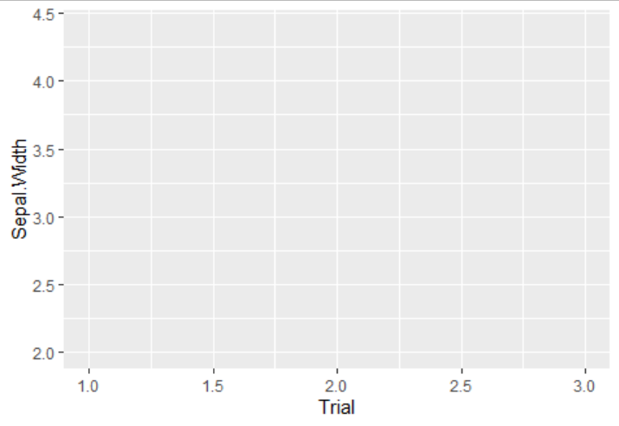
II. Structure
1. Data
2. Function
df %>%
ggplot(., aes(x = x, y = y, …)) +
3. Coordinates
4. Mapping
5. Geometries
6. Scales
7. Facets
8. Themes

Slide 21
II. Structure
1. Data
2. Function
ggplot(., aes(x = x, y = y, …)) +
3. Coordinates
Considerations
Data positions for plot
Not necessary to specify here, but must be supplied in plot layers
Continuous Data
Coordinate according to the data
Discrete Data
At 1, 2, 3 etc. on axis
Alphabetical for character class
Level for factors class
4. Mapping
5. Geometries
6. Scales
7. Facets
8. Themes

Slide 22
II. Structure
1. Data
2. Function
ggplot(., aes(x = x, y = y, …)) +
3. Coordinates
Arguments
x =
y =
positional, not necessary to specify
for geometries that use count, y not accepted
4. Mapping
5. Geometries
6. Scales
100,000.00
10,000.00
Log(Value)
7. Facets
1,000.00
100.00
8. Themes
10.00
2000
2010
2020
Time

Slide 23
II. Structure
1. Data
2. Function
df %>%
ggplot(., aes(x = x, y = y, *= var1) +
3. Coordinates
4. Mapping
5. Geometries
6. Scales
7. Facets
8. Themes

Slide 24
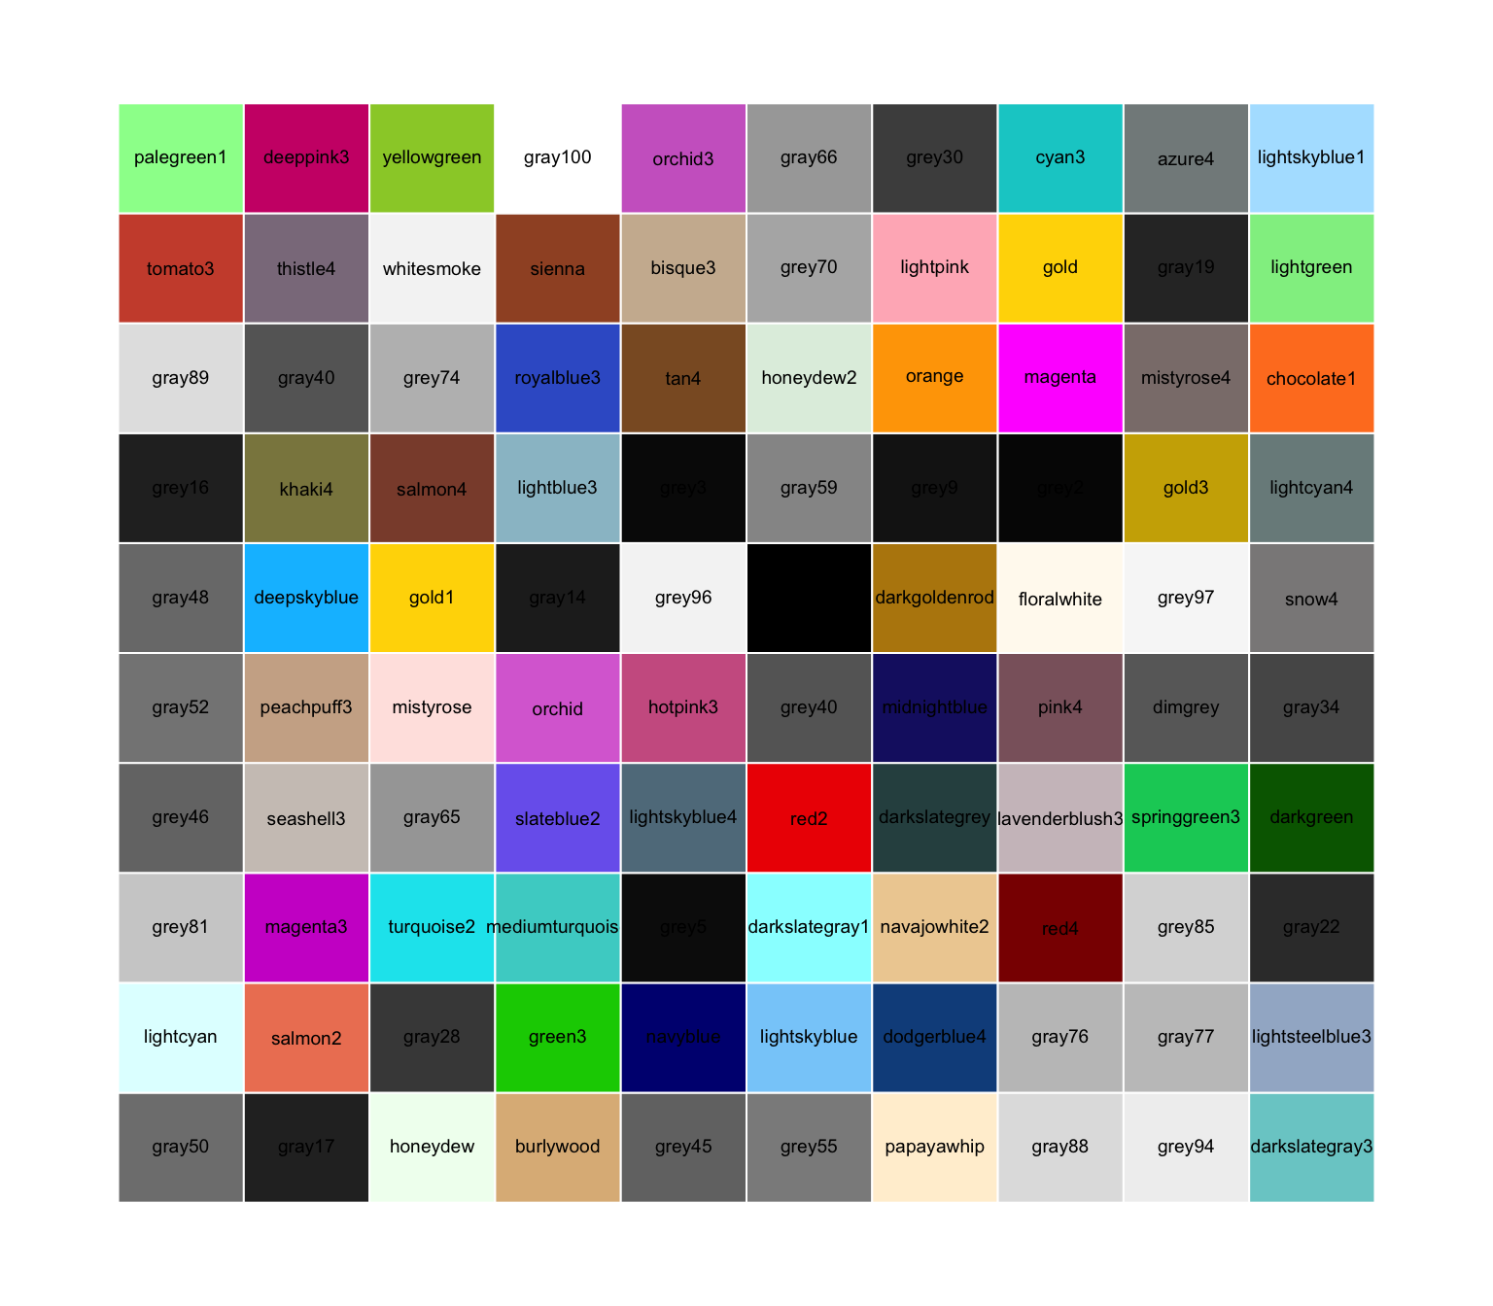
II. Structure
1. Data
2. Function
ggplot(., aes(x = x, y = y, * = var1) +
3. Coordinates
Considerations
Variables are mapped to visual properties (aesthetics)
Choosing the aesthetic (*)
Color
Fill
Size
Shape
Linetype
Transparency
Is the Continuous or Discrete?
What are you mapping to?
4. Mapping
5. Geometries
6. Scales
7. Facets
8. Themes

Slide 25
II. Structure
1. Data
2. Function
ggplot(., aes(x = x, y = y, * = var1) +
3. Coordinates
Arguments
Mappings can be set in ggplot()
- ggplot(.,aes(color = var1))
Mappings can be set in individual layers
- geom_point(.,aes(color = var1))
What is outside of the mapping will be interpreted literally
- geom_point(.,aes(color = ‘var1’))
Levels of the mapping are set in scales, else:
- (.,aes(), color = ‘black’)
4. Mapping
5. Geometries
6. Scales
7. Facets
8. Themes

Slide 26
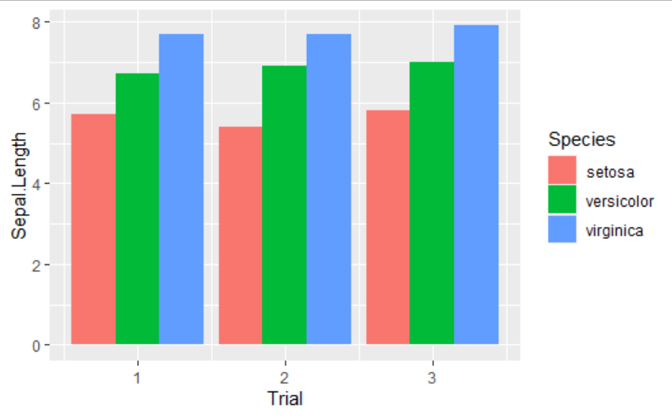
II. Structure
1. Data
2. Function
df %>%
ggplot(., aes(x = x, y = y, * = var1))+
geom_*(…) +
3. Coordinates
4. Mapping
5. Geometries
6. Scales
7. Facets
8. Themes

Slide 27
II. Structure
1. Data
2. Function
Considerations
What kind of visual representations (*) are the best approach?
Types of Geometry
Reference Lines
Barcharts
Dots and points
Boxplots
Heatmaps
Maps
Density
Polygons
Jitters
Error Bars
Text and Labels
geom_*(…) +
3. Coordinates
4. Mapping
5. Geometries
key point here
**
6. Scales
***
*
7. Facets
8. Themes
Notes:
these are our attributes

Slide 28
II. Structure
1. Data
2. Function
Considerations
What kind of visual representations (*) are the best approach?
Types of Geometry
Reference Lines
Barcharts
Dots and points
Boxplots
Heatmaps
Maps
Density
Polygons
Jitters
Error Bars
Text and Labels
geom_*(…) +
3. Coordinates
4. Mapping
Foundation: Graph Attributes
5. Geometries
key point here
**
6. Scales
***
*
7. Facets
8. Themes
Notes:
these are our attributes

Slide 29
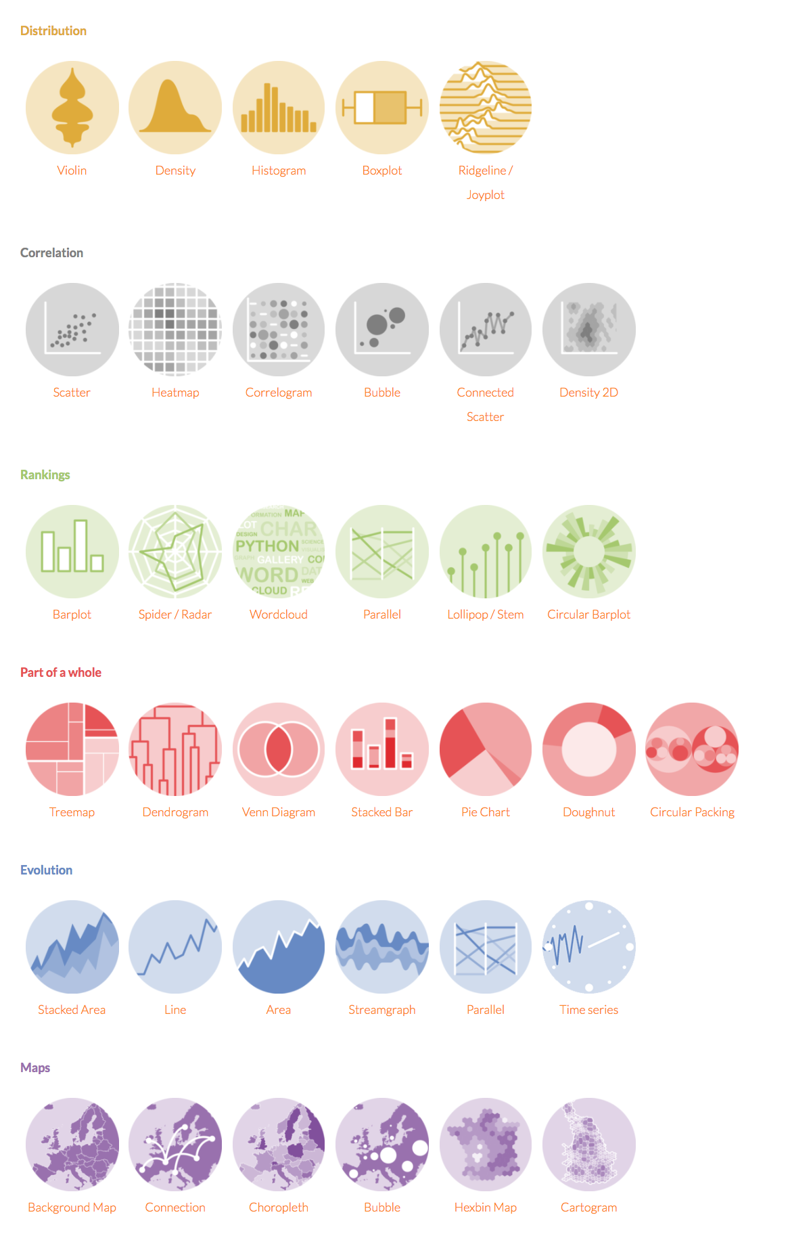
II. Structure
1. Data
2. Function
Arguments
Over 40 individual geoms
geom_*()
geom_point()
geom_hist()
geom_bar()
geom_col()
geom_tile()
Can build individual mappings within geoms_*()
Can add multiple geometries as annotation layers
Know the defaults
geom_*(mapping =, data =, stat = , position = )
geom_*(…) +
3. Coordinates
4. Mapping
5. Geometries
6. Scales
7. Facets
8. Themes

Slide 30
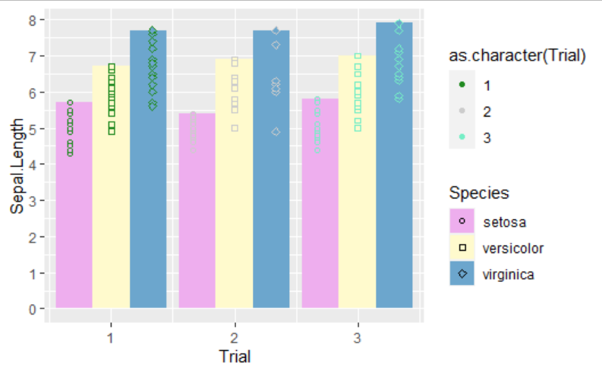
II. Structure
1. Data
2. Function
df %>%
ggplot(., aes(x = x, y = y, * = var1))+
geom_*(…) +
scale_*_*(…) +
3. Coordinates
4. Mapping
5. Geometries
6. Scales
7. Facets
8. Themes

Slide 31
II. Structure
1. Data
2. Function
scale_*_*(…) +
3. Coordinates
Concept
Specify Data and Mappings
Set arguments for coordinates (*)
x
y
Set arguments for mappings (*)
color
fill
alpha
linetype
… and many more
Different calls for discrete and continuous data types
Commonly used defaults are prebuilt
4. Mapping
5. Geometries
6. Scales
7. Facets
8. Themes

Slide 32
II. Structure
1. Data
2. Function
scale_*_*(…) +
3. Coordinates
Arguments
scale_*_*(
name = ,
breaks = ,
values = ,
labels = ,
limits = ,
trans = ,
guide = ,
position = ,
….)
100,000.00
4. Mapping
10,000.00
5. Geometries
Log(Value)
1,000.00
6. Scales
100.00
7. Facets
10.00
8. Themes
2000
2010
2020
Time
Notes:
Attibributes

Slide 33
II. Structure
1. Data
2. Function
scale_*_*(…) +
Standard Axis Scales
scale_x_continous(…)
scale_y_continous(…)
scale_x_discrete(…)
scale_y_discrete(…)
Pre-Built Custom Axis Scales
scale_*_log10(...)
scale_*_reverse(...)
scale_*_sqrt(...)
scale_*_datetime(…)
… and many more
3. Coordinates
100,000.00
4. Mapping
10,000.00
Log(Value)
5. Geometries
1,000.00
100.00
6. Scales
10.00
7. Facets
2000
2010
2020
Time
8. Themes

Slide 34
II. Structure
1. Data
2. Function
scale_*_*(…) +
Standard Alpha Scales
scale_alpha_continous(…)
scale_alpha_discrete(…)
Standard Shape Scales
scale_shape_continous(…)
scale_shape_discrete(…)
Standard Linetype Scales
scale_linetype_continous(…)
scale_linetype_discrete(…)
… and many more Standard
… and many more Pre-Built
3. Coordinates
4. Mapping
5. Geometries
6. Scales
7. Facets
8. Themes

Slide 35
II. Structure
1. Data
2. Function
scale_*_*(…) +
Standard Color Scales
scale_color_continous(…)
scale_fill_continous(…)
scale_color_manual(…)
scale_fill_manual(…)
Pre-Built Custom Color Scales
scale_*_brewer(...)
scale_*_gradient(...)
scale_*_gradientn(...)
scale_*_viridis(…)
… and many more
3. Coordinates
4. Mapping
5. Geometries
6. Scales
7. Facets
8. Themes

Slide 36
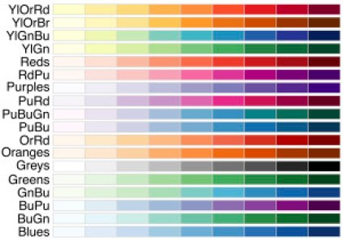
II. Structure
1. Data
2. Function
scale_*_*(…) +
3. Coordinates
Standard Scale – specify colors
scale_color_manual(values = c(‘red’, ‘green’, ‘blue’)
Pre-Built Custom Color Scales
scale_*_brewer(
type =,
palette = ,
direction = ,
aesthetics = )
scale_color_brewer(palete = ‘set2’)
4. Mapping
5. Geometries
6. Scales
7. Facets
8. Themes

Slide 37
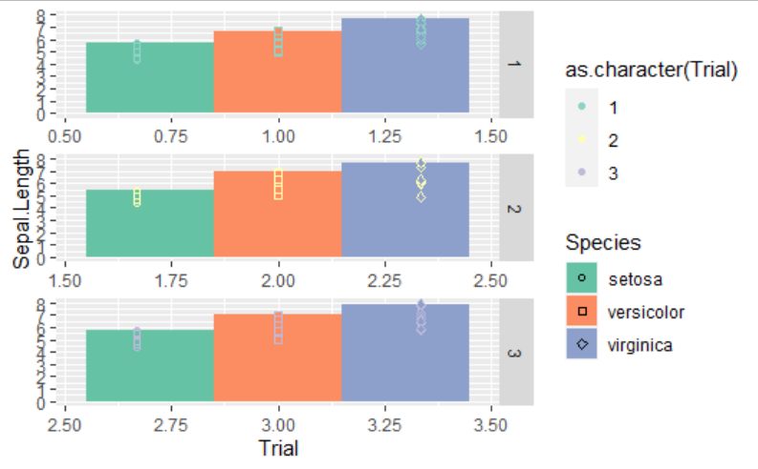
II. Structure
1. Data
df %>%
ggplot(., aes(x = x, y = y, * = var1) +
geom_*(….) +
scale_*_*(…) +
facet_*(…)
2. Function
3. Coordinates
4. Mapping
5. Geometries
6. Scales
7. Facets
8. Themes

Slide 38
II. Structure
1. Data
2. Function
facet_*(…) +
3. Coordinates
Concept
Highlight levels in data through multiple panels
facet_wrap(…)
creates a ribbon of levels
facet_grid(…)
creates a matrix of rows and columns of variable combinations
Arguments
nrow =,
ncol =,
scales = ,
shrink =,
labeller = ,
strip.position = ,
…)
4. Mapping
5. Geometries
6. Scales
7. Facets
8. Themes

Slide 39

II. Structure
1. Data
df %>%
ggplot(., aes(x = x, y = y, * = var1) +
geom_*(….) +
scale_*_*(…) +
facet_*(…) +
theme(…)
2. Function
3. Coordinates
4. Mapping
5. Geometries
6. Scales
7. Facets
8. Themes

Slide 40
II. Structure
1. Data
2. Function
theme(…)
Concept
Encompasses ALL the options of ggplot2:: plot ‘Elements’
4 main modifiers
line: all line elements
rect: all rectangular elements
text: all text elements
title: all title elements (including: plot, axes, legends..)
Pre-built themes available
theme_bw(…)
theme_grey(…)
ggthemes::
- a package with a wider selection of Pre-Built themes
3. Coordinates
4. Mapping
5. Geometries
6. Scales
7. Facets
8. Themes
Notes:
Elements

Slide 41
II. Structure
1. Data
2. Function
theme(…)
Concept
Encompasses ALL the options of ggplot2:: plot ‘Elements’
4 main modifiers
line: all line elements
rect: all rectangular elements
text: all text elements
title: all title elements (including: plot, axes, legends..)
Pre-built themes available
theme_bw(…)
theme_grey(…)
ggthemes::
- a package with a wider selection of Pre-Built themes
3. Coordinates
4. Mapping
5. Geometries
6. Scales
7. Facets
8. Themes
Foundation: Graph Elements
Notes:
Elements

Slide 42
II. Structure
1. Data
2. Function
theme(…) +
3. Coordinates
Argument
The main modifiers:
- theme(
text* = element_text(),
panel* = element_rect(),
axis* = element_line(),
title* = element_text())
where * = …
4. Mapping
5. Geometries
6. Scales
7. Facets
8. Themes

Slide 43
II. Structure
1. Data
2. Function
theme(…) +
3. Coordinates
theme(
aspect.ratio,
axis.title,
axis.title.x,
axis.title.x.top,
axis.title.x.bottom,
axis.title.y,
axis.title.y.left,
axis.title.y.right,
axis.text,
axis.text.x,
axis.text.x.top,
axis.text.x.bottom,
axis.text.y,
axis.text.y.left,
axis.text.y.right,
axis.ticks,
axis.ticks.x,
axis.ticks.x.top,
axis.ticks.x.bottom,
axis.ticks.y,
axis.ticks.y.left,
axis.ticks.y.right,
axis.ticks.length,
axis.ticks.length.x,
axis.ticks.length.x.top,
axis.ticks.length.x.bottom,
axis.ticks.length.y,
axis.ticks.length.y.left,
axis.ticks.length.y.right,
axis.line,
axis.line.x,
axis.line.x.top,
axis.line.x.bottom,
axis.line.y,
axis.line.y.left,
axis.line.y.right,
legend.background,
legend.margin,
legend.spacing,
legend.spacing.x,
legend.spacing.y,
legend.key,
legend.key.size,
legend.key.height,
legend.key.width,
legend.text,
legend.text.align,
legend.title,
legend.title.align,
legend.position,
legend.direction,
legend.justification,
legend.box,
legend.box.just,
legend.box.margin,
legend.box.background,
legend.box.spacing,
panel.background,
panel.border,
panel.spacing,
panel.spacing.x,
panel.spacing.y,
panel.grid,
panel.grid.major,
panel.grid.minor,
panel.grid.major.x,
panel.grid.major.y,
panel.grid.minor.x,
panel.grid.minor.y,
panel.ontop,
plot.background,
plot.title,
plot.title.position,
plot.subtitle,
plot.caption,
plot.caption.position,
plot.tag,
plot.tag.position,
plot.margin,
strip.background,
strip.background.x,
axis.ticks.length.x.bottom,
strip.background.x, strip.background.y,
strip.placement,
strip.text,
strip.text.x,
strip.text.y,
strip.switch.pad.grid,
strip.switch.pad.wrap,
...,)
4. Mapping
5. Geometries
6. Scales
7. Facets
8. Themes

Slide 44
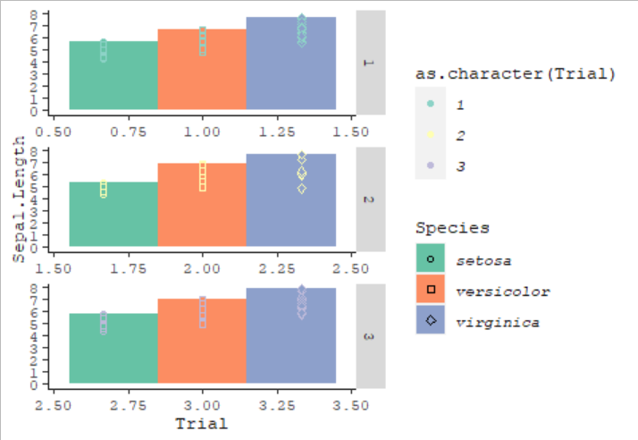
bar graph
sample
measurements
color is species
dodged
facetted width and length
III. Application
Sketch
Story

Slide 45
bar graph
sample
measurements
color is species
dodged
facetted width and length
III. Application
Facetted Width and Length
Bargraph
Trial axis breaks as ‘2010’, 2015’, ‘2020’
Y axis at 2, 4, 6, 8
Choose a different palette for species
Ditch the points, and accompanying scale
Dodge position
Species in italics
No grey in facet
New font
Sketch
Story

Slide 46
III. Application
Facetted Width and Length
Bargraph
Trial axis breaks as ‘2010’, 2015’, ‘2020’
Y axis at 2, 4, 6, 8
Choose a different palette for species
Ditch the points, and accompanying scale
Dodge position
Species in italics
No grey in facet
New font
bar graph
sample
measurements
color is species
dodged
facetted width and length
Petal Length
Petal Width
100,000.00
100,000.00
10,000.00
10,000.00
Log(Value)
Value
1,000.00
1,000.00
100.00
100.00
10.00
10.00
2000
2010
2020
2000
2010
2020
Time
Time
Sketch
Story

Slide 47
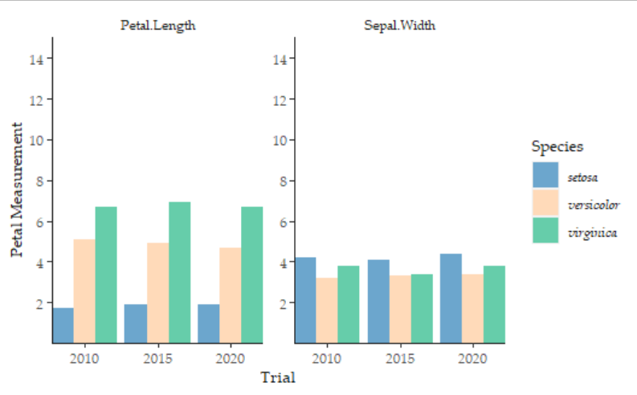
III. Application
bar graph
sample
measurements
color is species
dodged
facetted width and length
Petal Length
Petal Width
100,000.00
100,000.00
10,000.00
10,000.00
Log(Value)
Value
1,000.00
1,000.00
100.00
100.00
10.00
10.00
2000
2010
2020
2000
2010
2020
Time
Time
Sketch
Story

Slide 48
III. Application
bar graph
sample
measurements
color is species
dodged
facetted width and length
Petal Length
Petal Width
100,000.00
100,000.00
10,000.00
10,000.00
Log(Value)
Value
1,000.00
1,000.00
100.00
100.00
10.00
10.00
2000
2010
2020
2000
2010
2020
Time
Time
Polished
Story

Slide 49
III. Application
This is just one round of editing!
What else would you change???
Polished

Slide 50
Conclusions
Troubleshooting
Class of data: counts or continuous data?
Layer, layer, layer, order matters
What are the arguments within the function
Change the default or consider an alternate geom/function
Are you invoking a discrete call on continuous data?
Did you set color when you meant fill?
Did you specify the multiple arguments for the same item?
The last one will be what is seen, check your code.
Is the default of the function to use a count transform?

Slide 51
Conclusions
Resources for working in R
ggplot2.tidyverse/org
ggplot2-book.org/
www.r-graph-gallery.com/
tidytuesday podcast and webpage
Esquisse and Colors Add-Ins
Thomas lin Pedersen – ggplot2 – two-part series
Stackoverflow

Slide 52
Conclusions
Today’s Goal
Understand how to develop graphics that:
Effectively tell a story
In ggplot2 (and some tidyverse)
Are refined or highly refined.
100,000.00
Very Catchy Title
10,000.00
**
key point here
Log(Value)
1,000.00
***
100.00
*
10.00
2000
2010
2020
Time
ggplot(…)

Slide 53
Github: github.com/meghartwick/
LinkedIn: /meghan-hartwick-83291551/
Twitter: @HartwickMeghan

Slide 54
‘The question in R is not if it can be done, but how.’
Questions?

